Slide 1


Delivered By:
Rutik Wankhade Sahil Patre Karan Nagpure
Dipak Suryawanshi Mitali Mahalle Saloni Jawade
Group
B-07
6th Sem CE(B)
Under Guidance of:
Prof. S. P. Veer
Department of Computer Engineering
Bapurao Deshmukh College of Engineering, Sevagram
Academic Year : 2023 - 24
Mini Project Progress Seminar
AgroDataHub - Application

Slide 2
Contents
Introduction
Objective of Project Work
Literature Review
Technical Background
Home Page of Application
Farmer Data Form
Flowchart
Conclusion
Reference

Slide 3
Introduction
In contemporary agricultural practices, there exists a substantial gap in the efficient dissemination and utilization of crucial farming information among farmers. Limited access to data on optimal crop choices, effective cultivation practices, and regional production patterns hinders the ability of individual farmers to make informed decisions, optimize resource usage, and enhance overall productivity.
Additionally, the absence of a centralized platform for collaborative knowledge-sharing restricts the potential for community-driven advancements in agriculture.

Slide 4
Objectives of Project Work
Facilitate Knowledge Sharing:
  Create a platform that enables farmers to share their experiences, best practices, and success stories. Foster a collaborative community where farmers can learn from each other and collectively improve their farming techniques.
Empower Farmers with Information:
  Provide farmers with access to comprehensive information on optimal crop choices, effective cultivation practices, and region-specific insights . Empower farmers to make informed decisions that enhance productivity, reduce risks, and improve overall agricultural outcomes.
Data-Driven Decision-Making for Government:
  Provide government agencies with a robust dataset for informed policy formulation, resource allocation, and intervention strategies . Enable governments to design and implement targeted agricultural policies based on real-time and historical data.

Slide 5
Literature Review
Sr. NO | Details of Papers | Publisher | Work reported | Research Gaps identified
1. | "Enhancing Agricultural Data Management through a Collaborative Platform: The Case of AgroDataHub" | Journal of Agricultural Informatics, Volume 10, Issue 2, Year 2022 | The paper discusses the development and implementation of AgroDataHub, a collaborative platform designed to address challenges in agricultural data management. | Privacy and Security: Further research is needed to explore best practices for ensuring data privacy and security in AgroDataHub, and government access to data.

Slide 6
Literature Review
Sr. NO | Details of Papers | Publisher | Work reported | Research Gaps identified
2. | Empowering Smallholder Farmers through Digital Innovation: A Case Study of AgroDataHub in Rural Communities | International Journal of Agricultural Development, Volume 8, Issue 3, Year 2021 | The paper presents a case study of AgroDataHub's implementation in rural communities, focusing on its impact on smallholder farmers. | Gender Inclusivity: Investigating the gender dimensions of AgroDataHub adoption and usage, including barriers faced by women farmers and opportunities for gender-sensitive design.

Slide 7
Technical Background
Frontend Development with React Native:
React Native is a popular JavaScript framework for building native mobile applications for iOS and Android platforms.
It allows developers to write code once and deploy it across multiple platforms, saving time and effort in development.
React Native's component-based architecture and hot-reloading feature enable rapid iteration and efficient development of user interfaces.
Style components are utilized for styling React Native components, providing a streamlined approach to CSS styling in JavaScript.

Slide 8
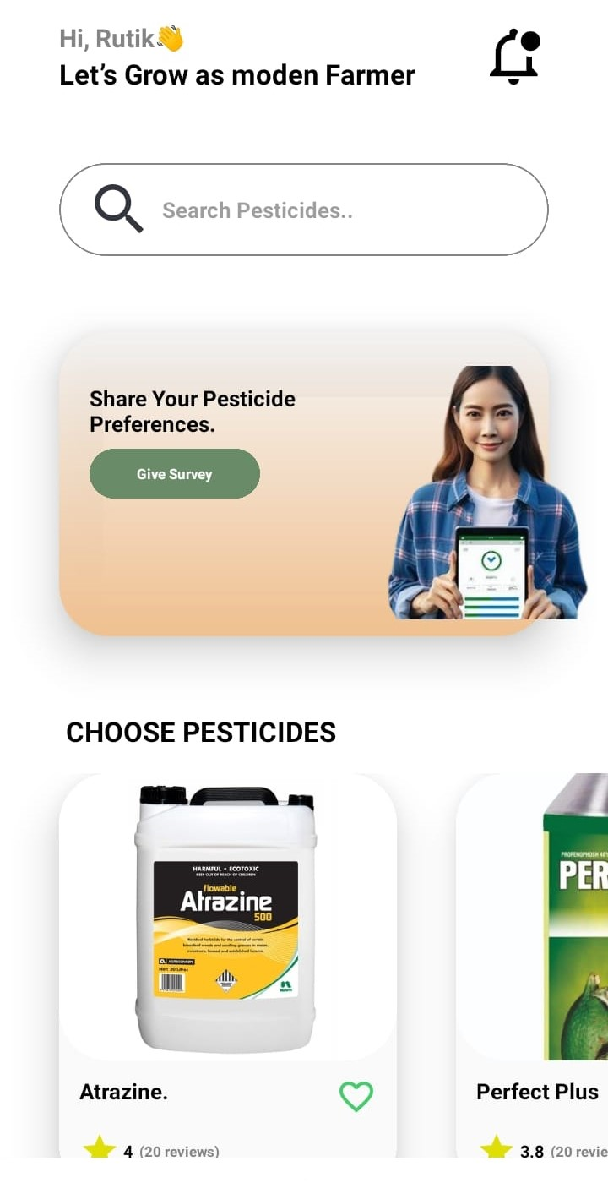
Home Page of Application
Screenshot of Home Page

Slide 9
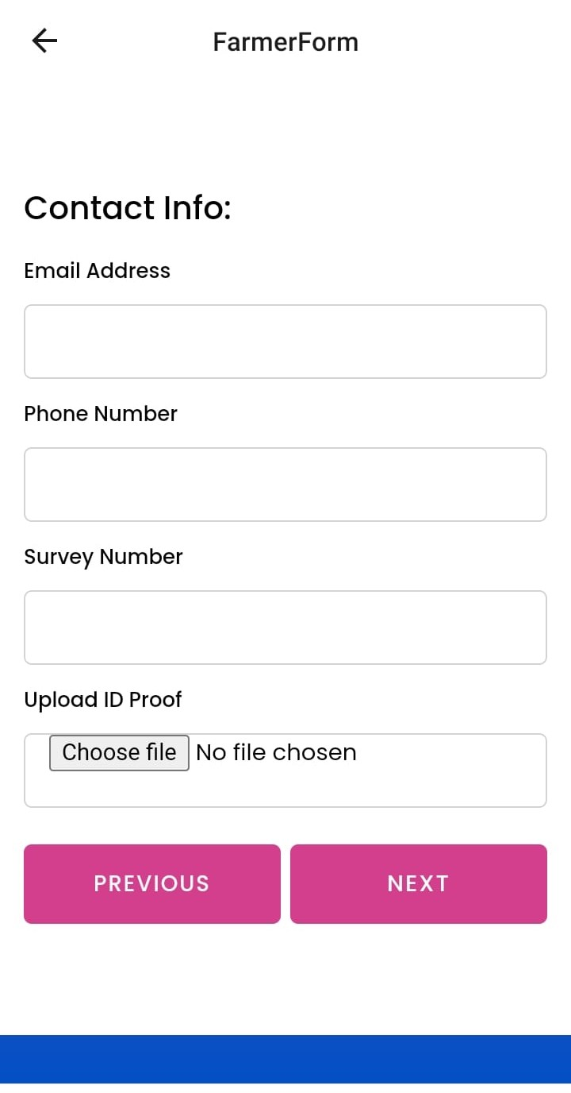
Farmer Data Form
Styling Part
Screenshot of Form Page

Slide 10
Technical Background
Backend Development with Node.js:
Node.js is a JavaScript runtime environment that allows developers to build scalable and high-performance server-side applications.
It provides a non-blocking, event-driven architecture, making it ideal for handling asynchronous operations such as database queries and API requests.
Database Management Firebase:
Web3API integration.
Firebase is a NoSQL cloud database service provided by Google, offering real-time data synchronization, offline capabilities, and automatic scaling.

Slide 11
Home Page of Application
Screenshot of Home Page

Slide 12
Flowchart
3
Start
Collecting Information About Farmer
Storing Data Related To Farmer
Showing Data To Farmer
Showing Data TO Agriculture Department
Analyze Data To Increase Productivity Of Crop
Disaster Response and Mangement
End
End

Slide 13
Work Progress
3
Integration of database and updating existing database
Integration of Web3 API
Improve Form UI to User Friendly UI
Add Updated Attributes
Gmail Notification Integration Added
Optimization Done
Database Integration Added
End

Slide 14
Conclusion
For farmers, it means smarter decisions, better crops, and more profit. They can easily manage their farm data, learn from others, and access crucial information right from their phones. Plus, it's all in a language they understand.
For governments, AgroDataHub offers a goldmine of insights. By tapping into this data, policymakers can tailor support programs, make informed policies, and respond quickly to crises, ensuring a healthier agricultural sector for everyone.
In short, AgroDataHub isn't just an app; it's a tool for growth, collaboration, and sustainability in farming. With its simple interface and powerful technology, it's set to change the game for agriculture, one farm at a time.

Slide 15
References
    Alston, J.M., G.W.Norton, and P.G.Pardey. 1995. Science Under Scarcity: Principles and Practice for Agricultural Research Evaluation and Priority Setting. Ithaca, N.Y.: Cornell University Press.
    Boehlje, M. 1999. Structural changes in the agricultural industries: How do we measure, analyze, and understand them? American Journal of Agricultural Economics 81(5): 1028–1041.
    Carr, P., G.Carlson, J.Jacobson, G.Nielson, and E.Skogley. 1991. Farming soils, not fields: A strategy for increasing fertilizer profitability. Journal of Production Agriculture
    Daberkow, S.G., and W.D.McBride. 2001. Information and the adoption of precision farming technologies. Selected paper for presentation at the 2001 American Agricultural Economics Association meetings, August 5–8. Economic Research Service, U.S. Department of Agriculture, Washington, D.C.
    Hoppe, R.A., and A.B.W.Effland. 1998. Women Farmers in the U.S. Agricultural Outlook, May. Washington, D.C.: Economic Research Service, U.S. Department of Agriculture.

Slide 16


Slide 17
Questions
?

